Slide 1

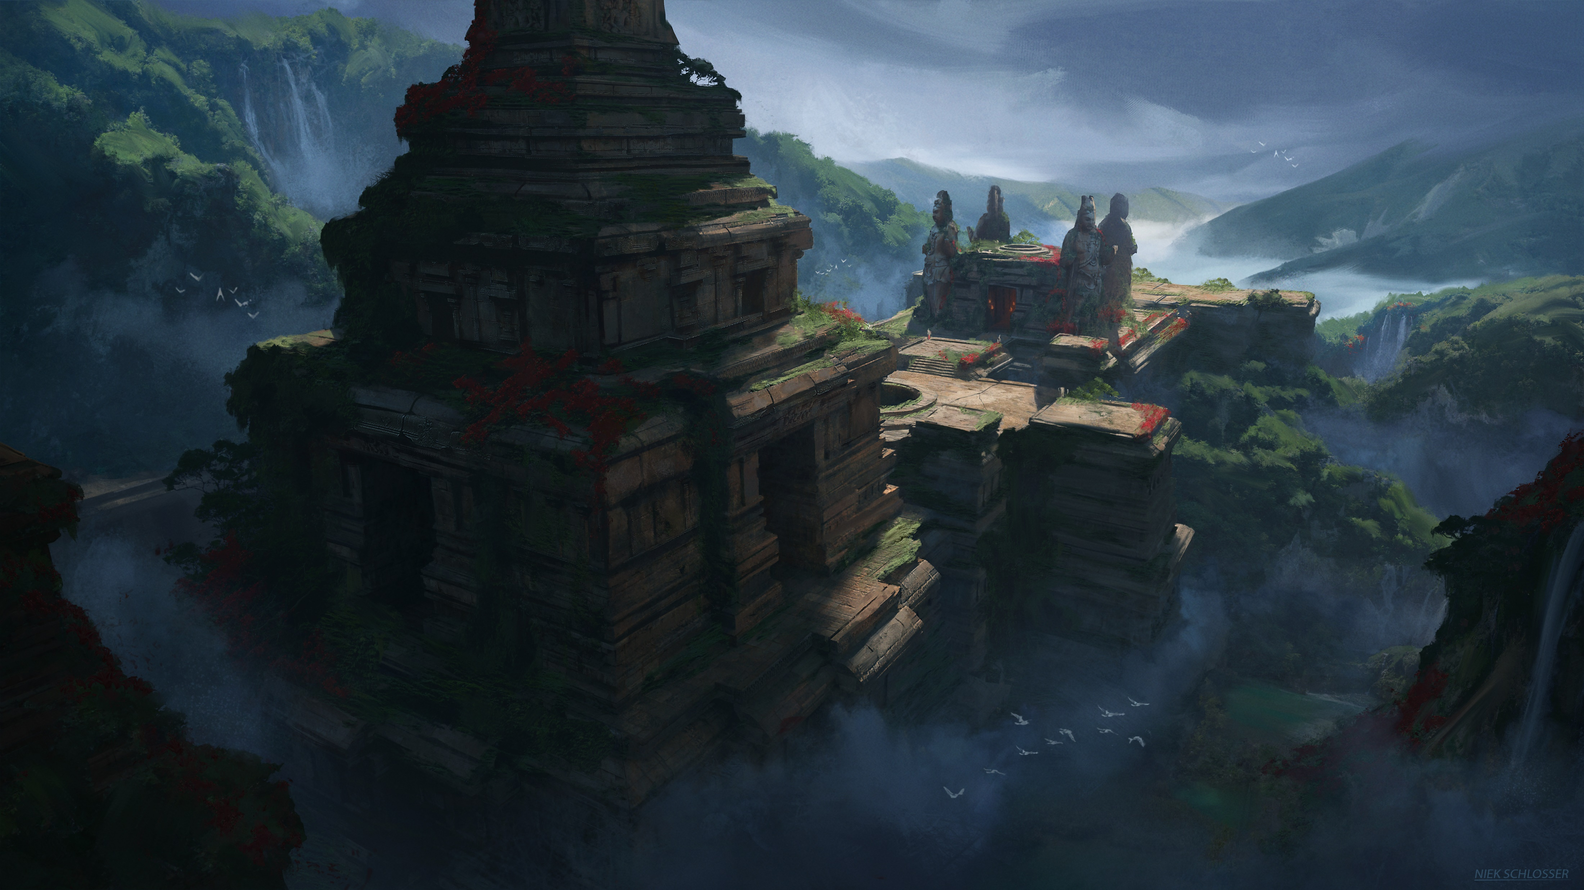
Eindpresentatie
Door:
Niek Schlosser
Benjamin Vos
Sunray Muijsson
Rick Greeve

Slide 2
Inhoudsopgave
Planning en Repository
Game onderdelen
Concept art
3D Environment Art
3D Character Art
3D Weapon Art

Slide 3
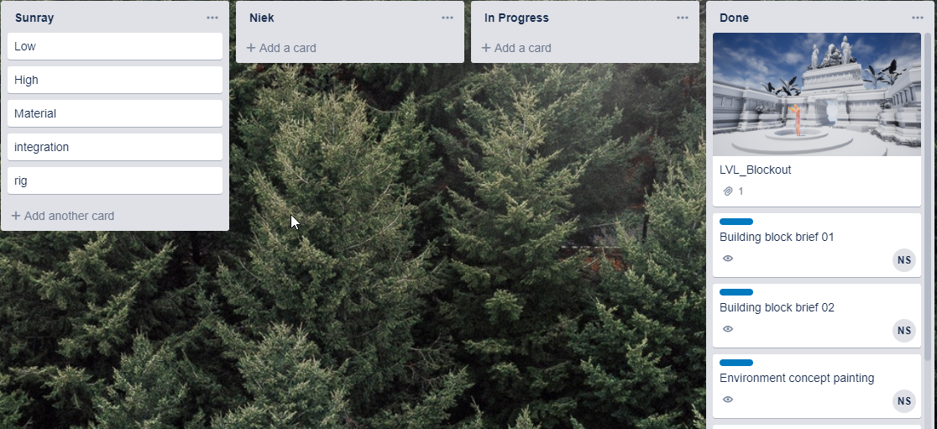
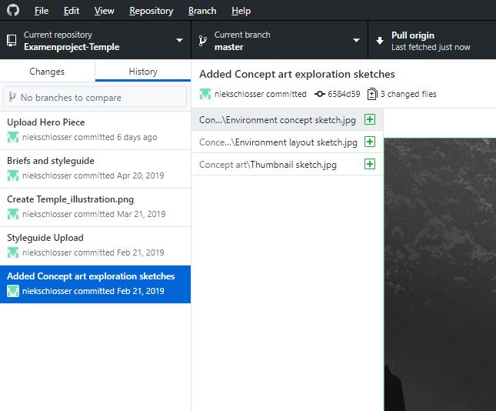
Planning en Repository
TRELLO
GITHUB

Slide 4
Game onderdelen
Game-onderdelen i.p.v. een Game
Niek Schlosser: Concept Art
Benjamin Vos: 3D Environment Art
Sunray Muijsson: 3D Character Art
Rick Greeve: 3D Weapon Art

Slide 5
Concept Art
Door: Niek Schlosser
Styleguide
Schetsen
Environment Illustration V1
Environment Illustration Final
Building Blocks 001
Building Blocks 002
Hero piece

Slide 6
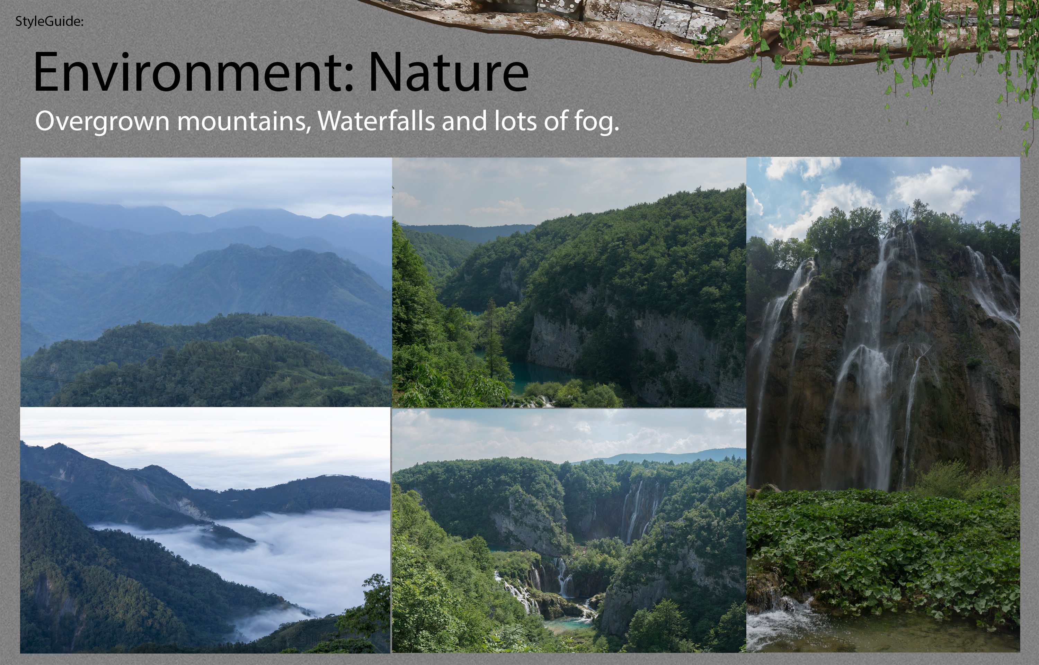

Slide 7
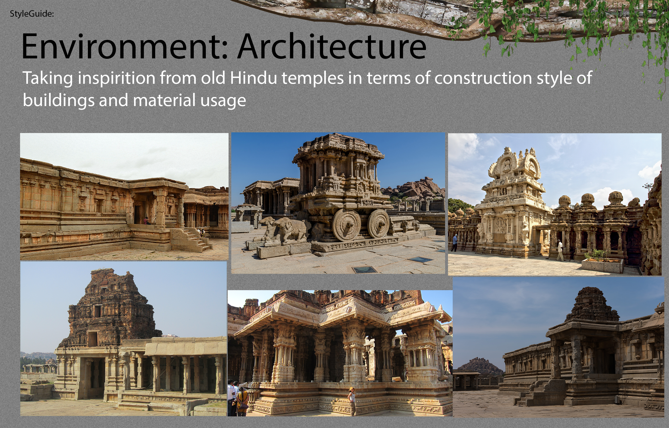

Slide 8
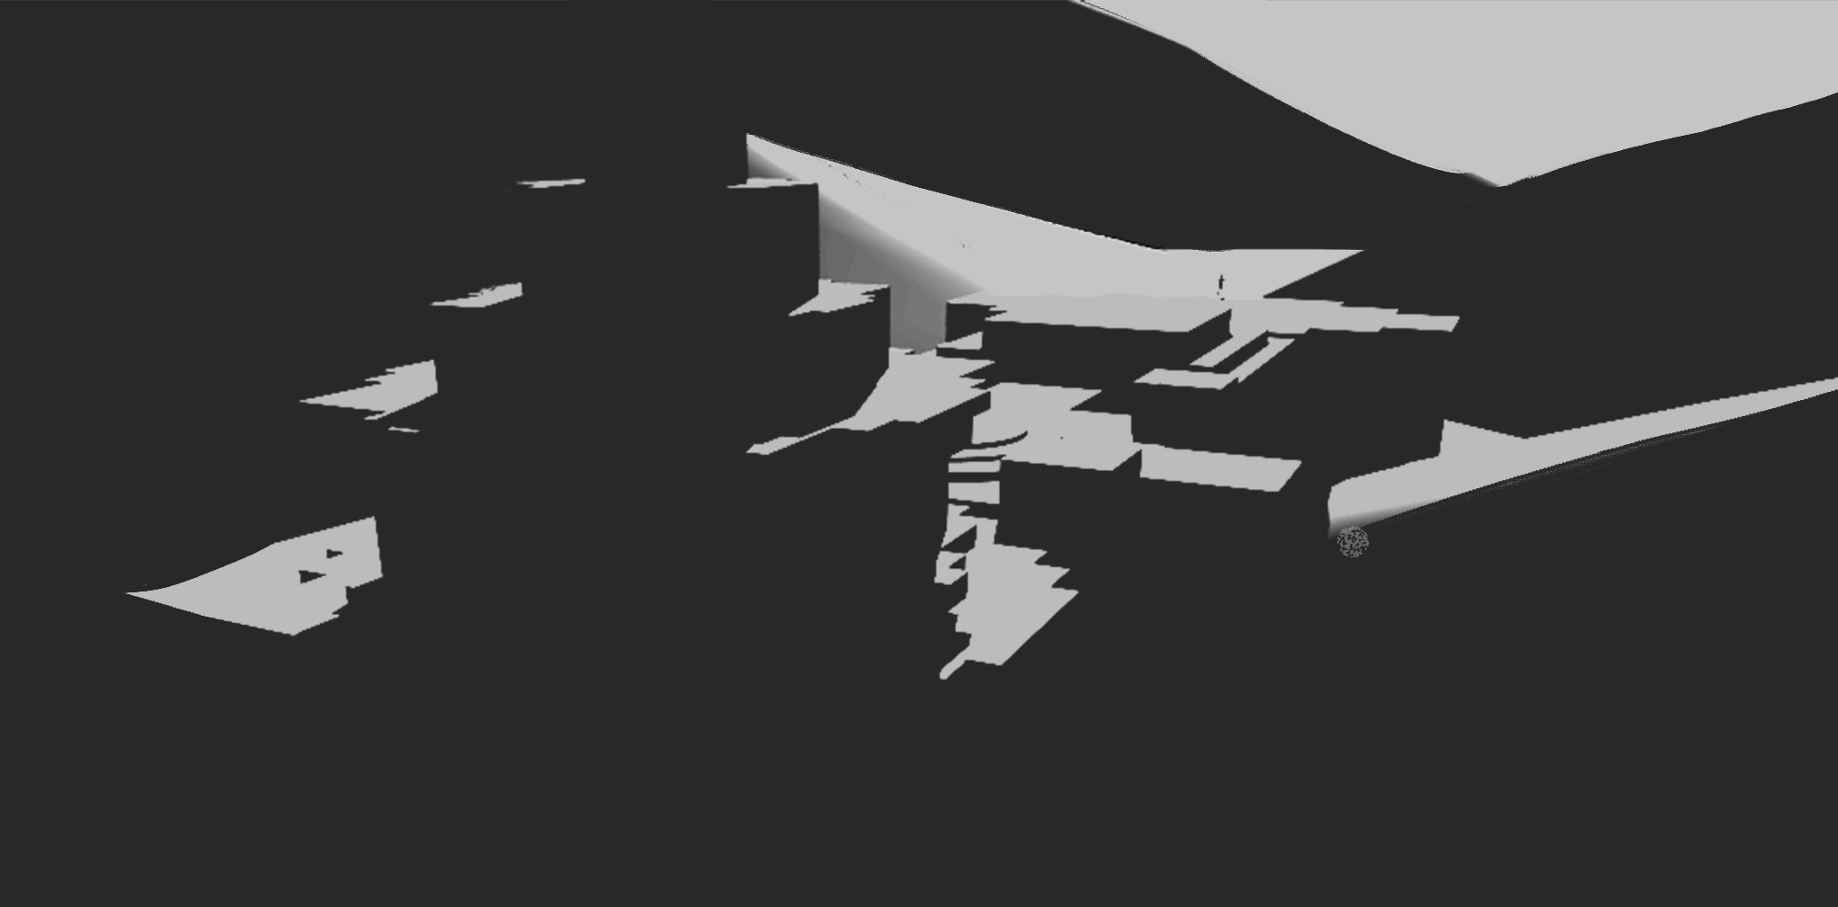
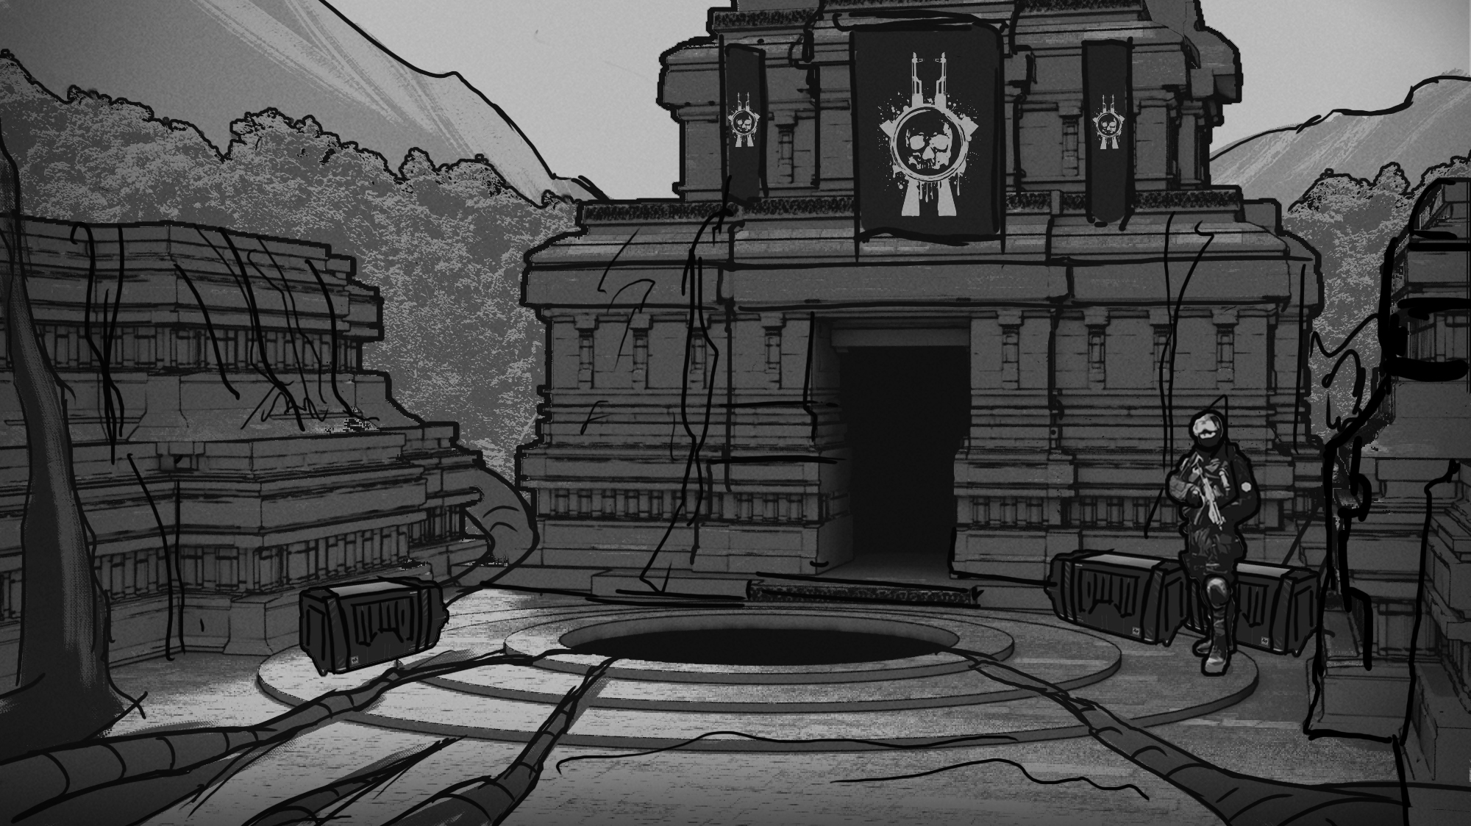
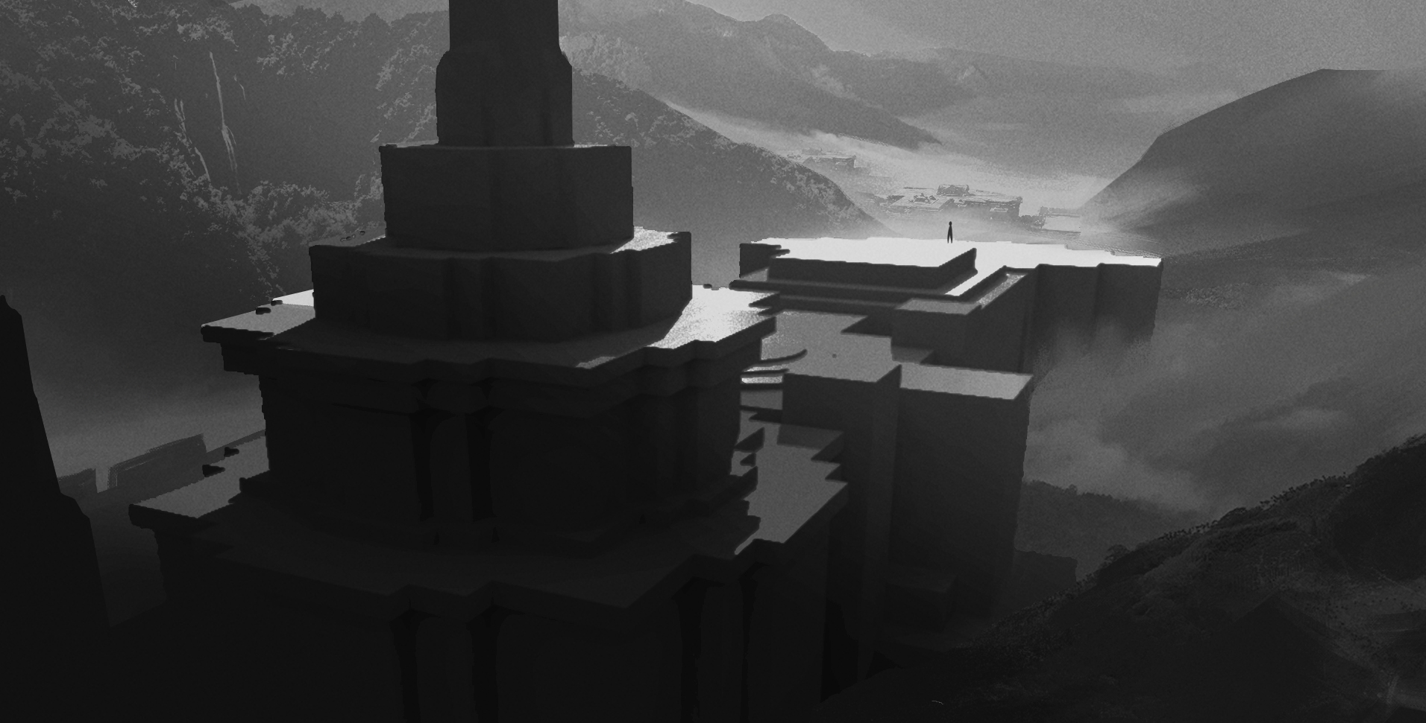

Slide 9
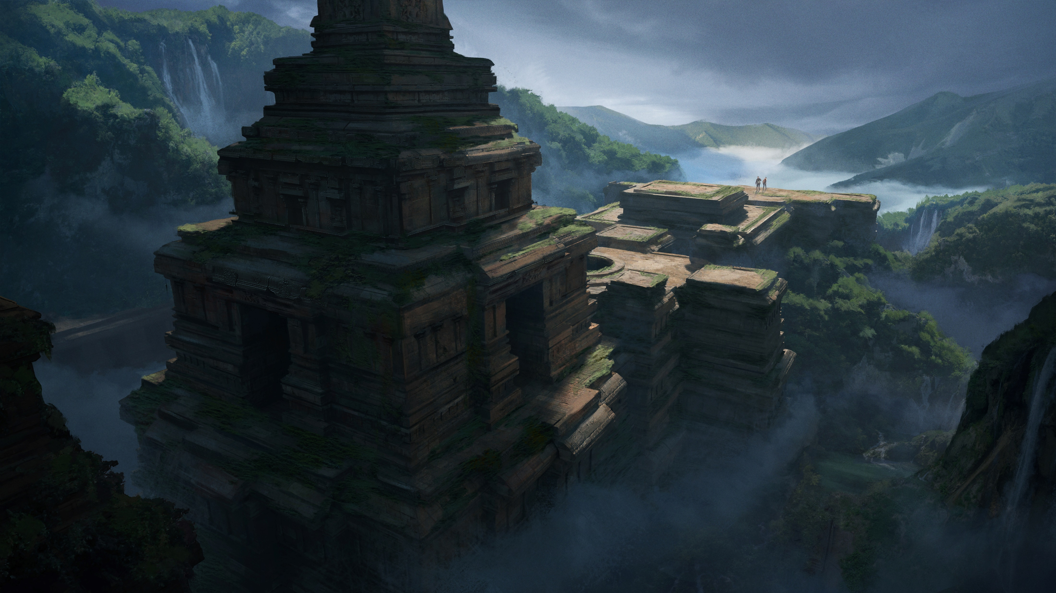

Slide 11
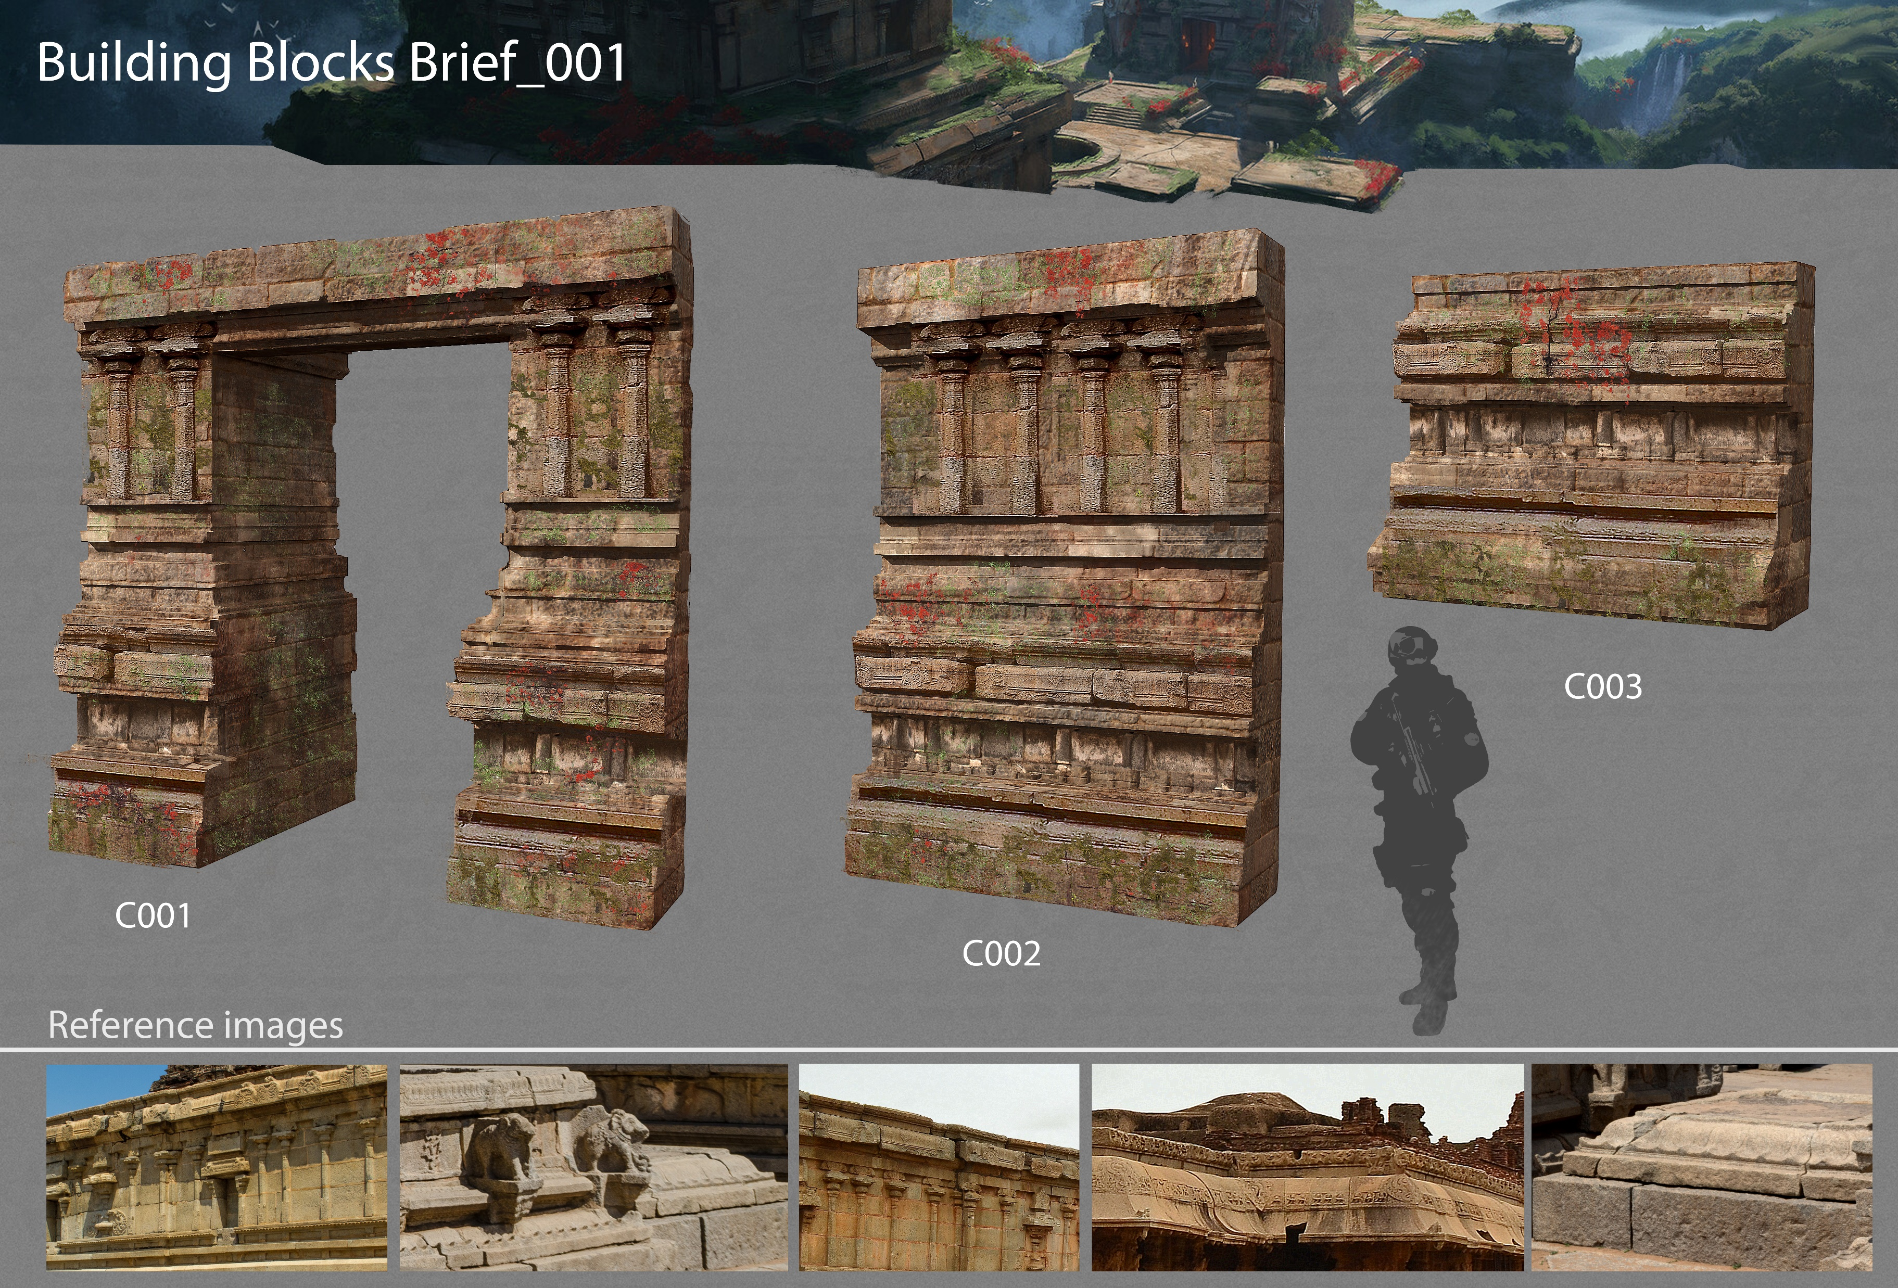

Slide 12
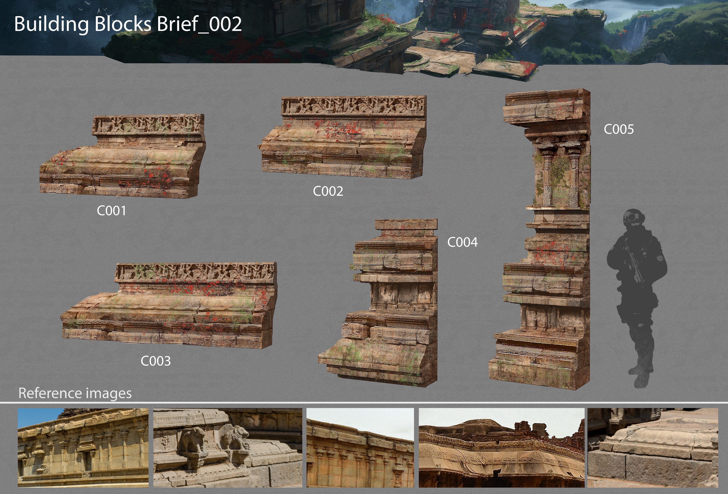

Slide 13
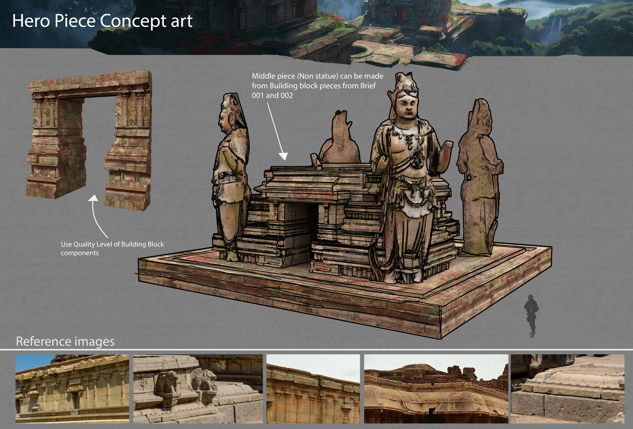

Slide 14
3D Environment Art
Door: Benjamin Vos
Environment Renders
High Poly Render
Plants en Building block Renders

Slide 15
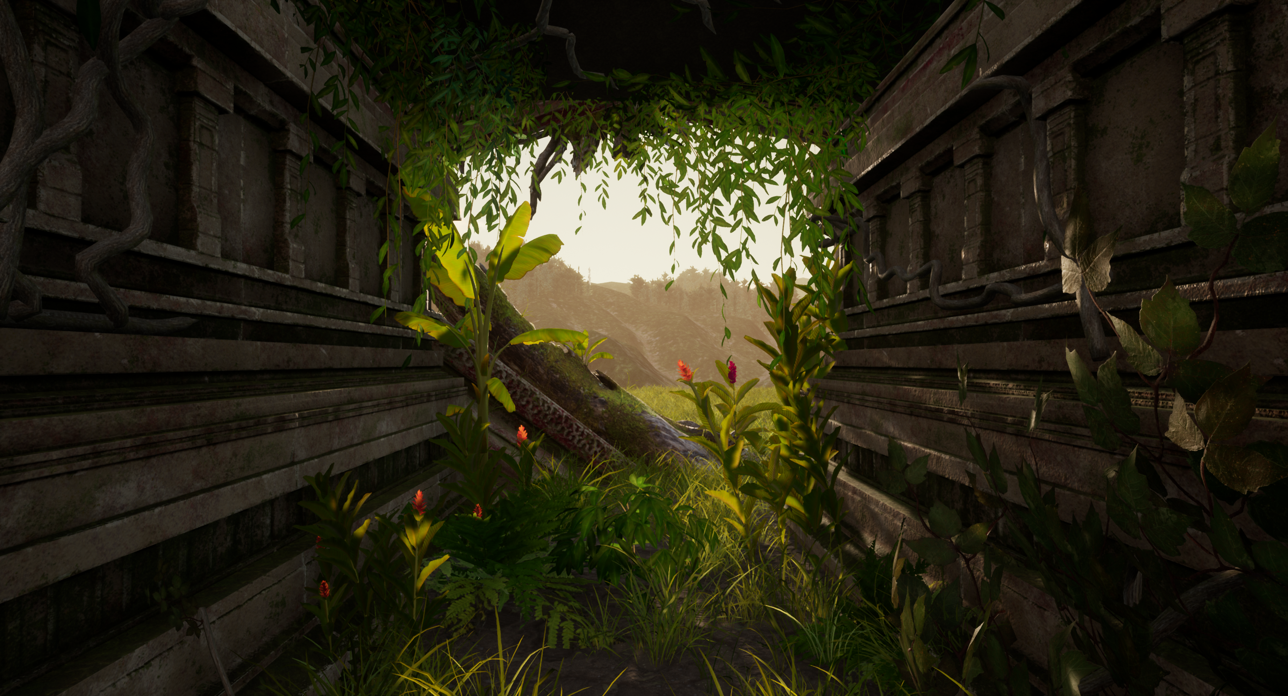

Slide 16
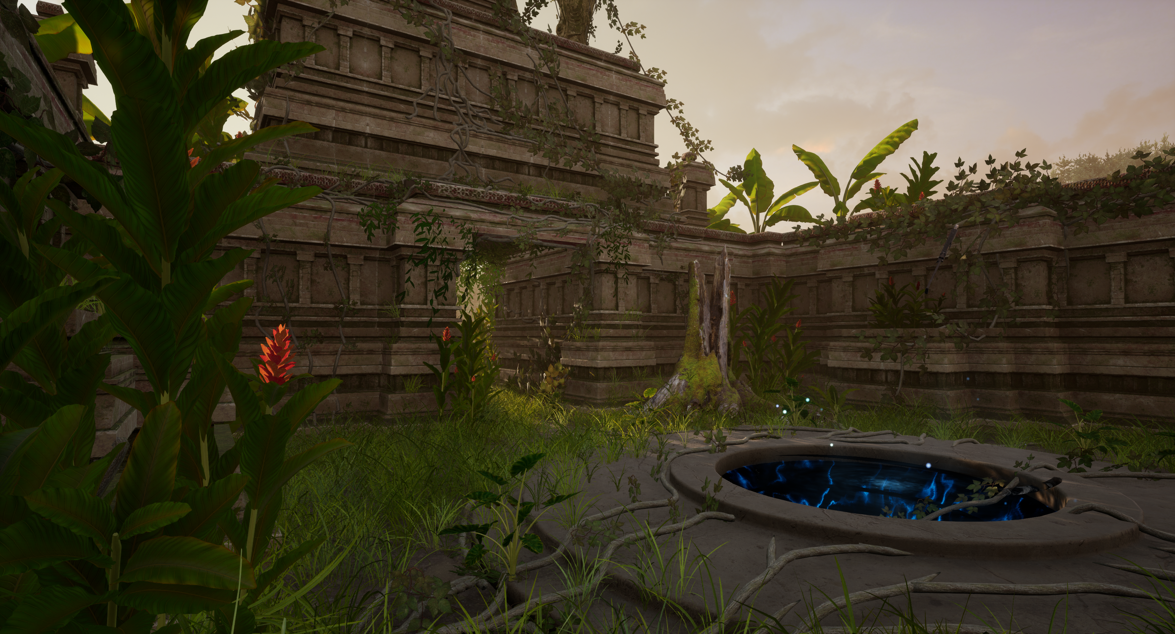

Slide 17
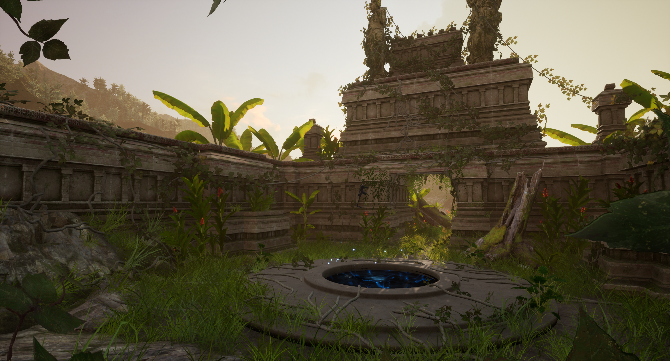

Slide 18
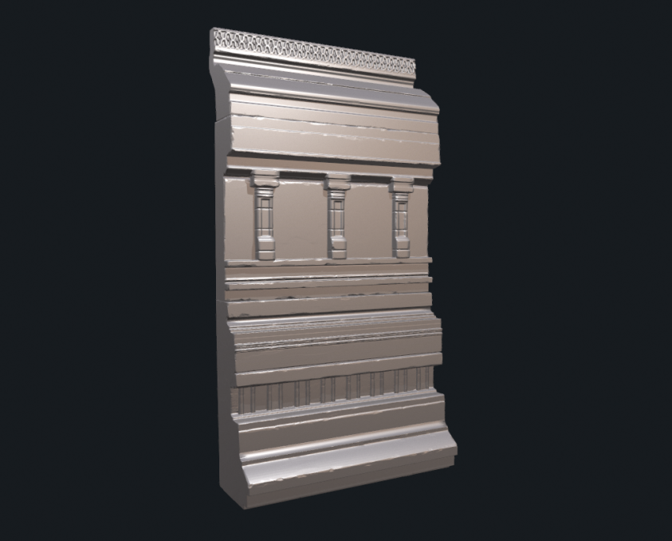
High Poly temple piece

Slide 19
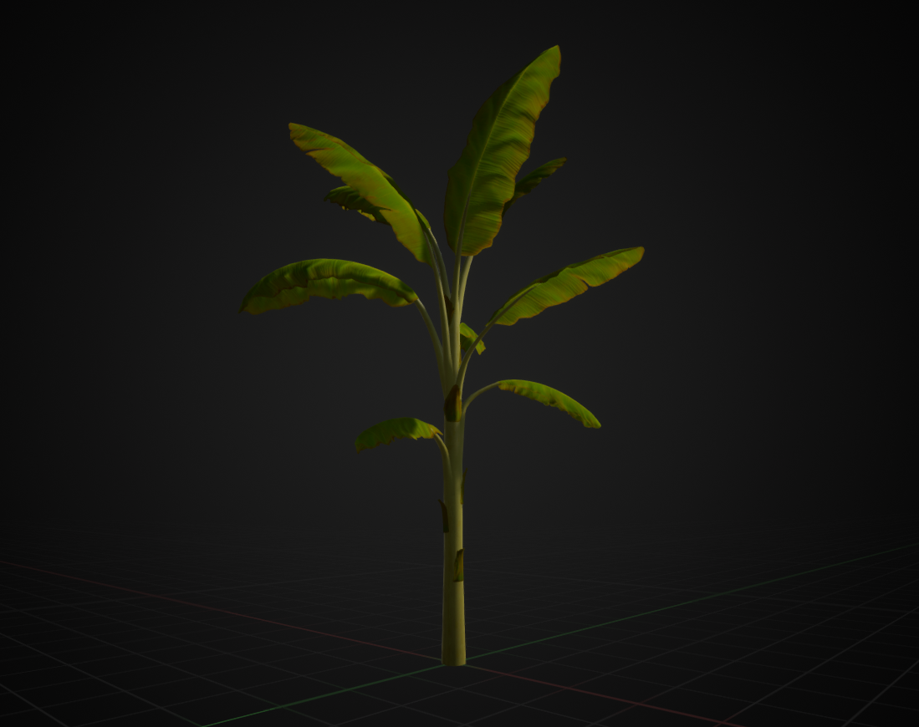
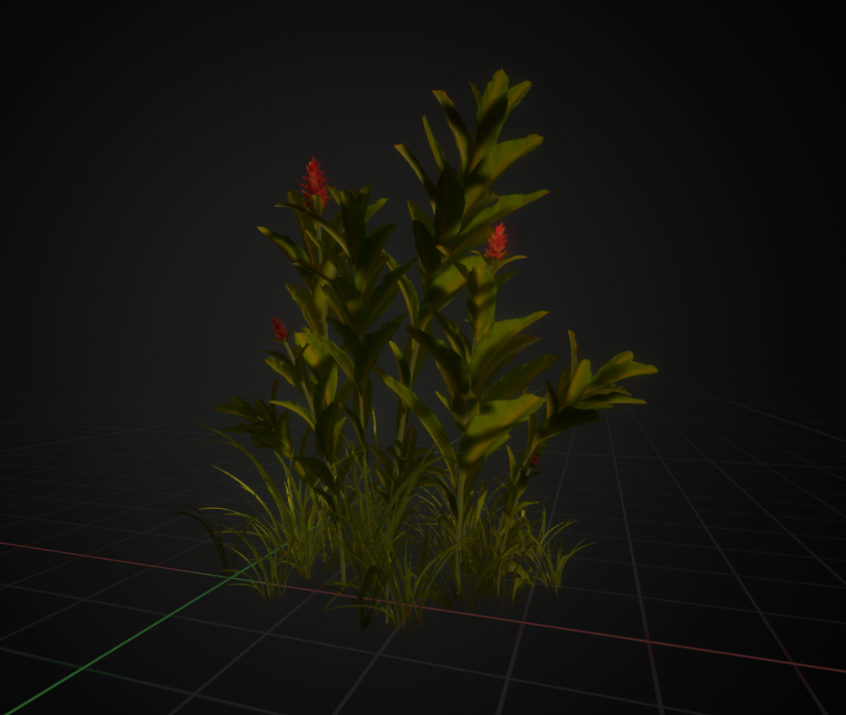

Slide 20
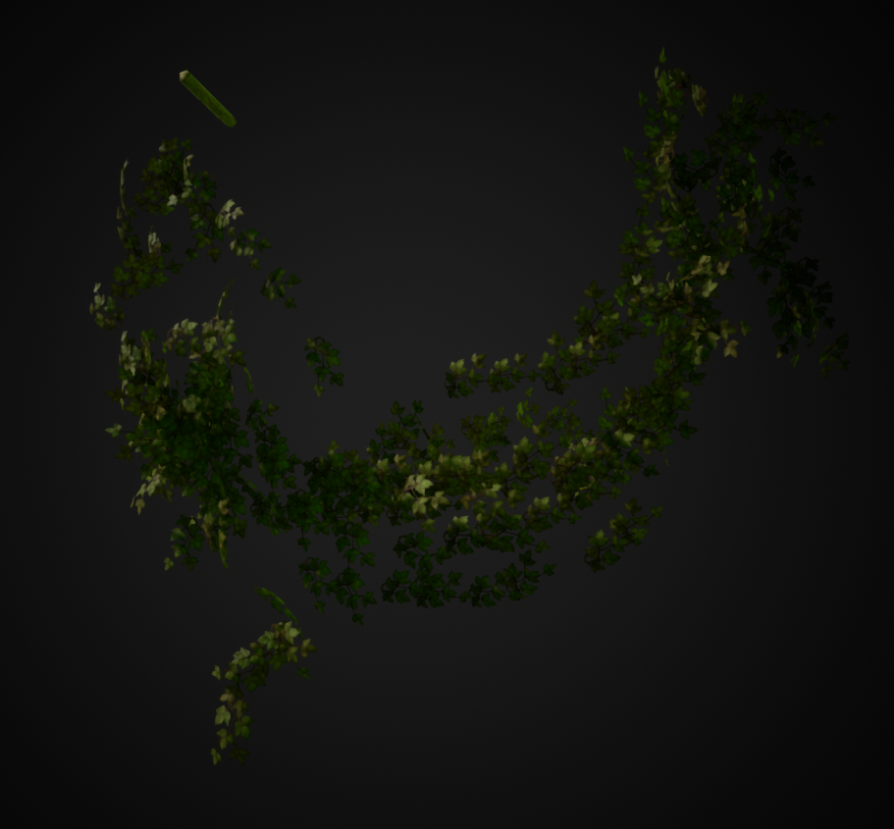
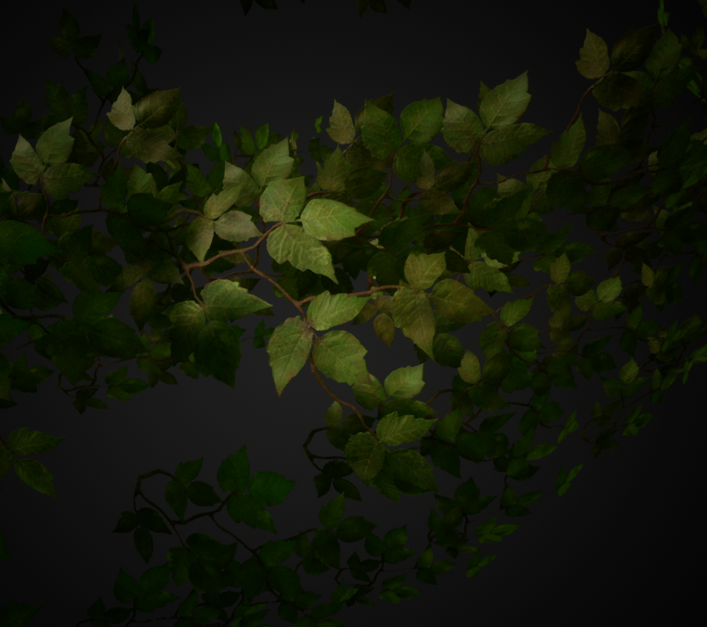

Slide 21
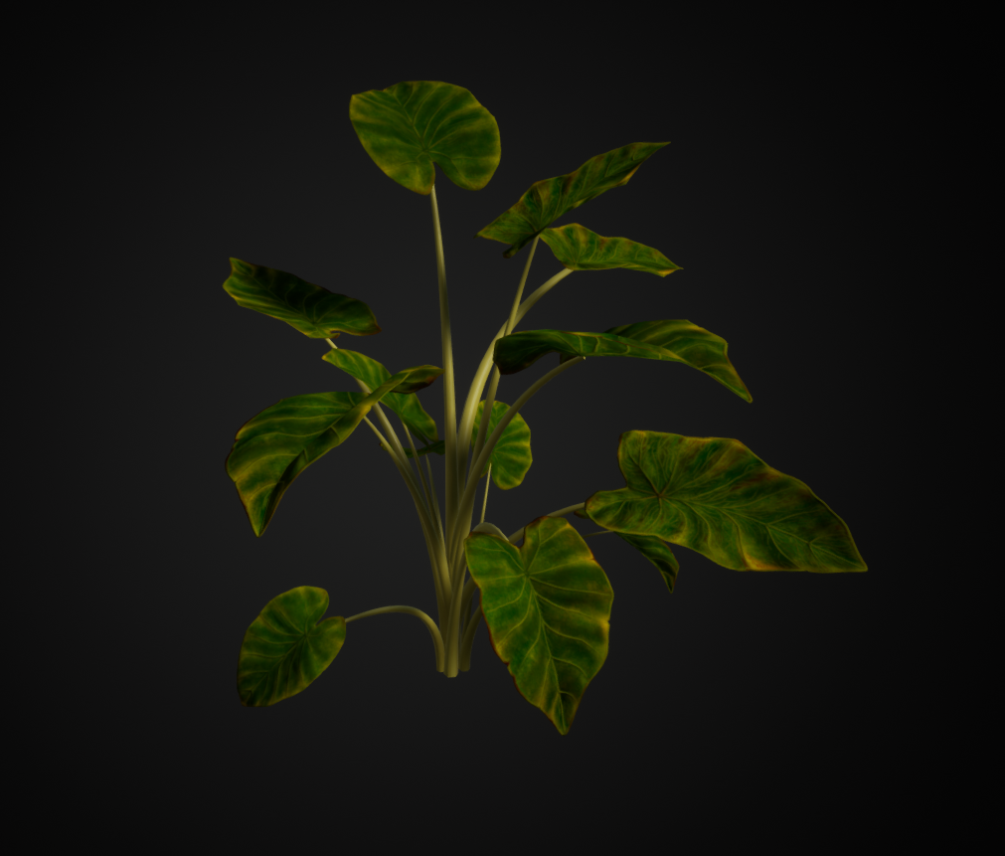
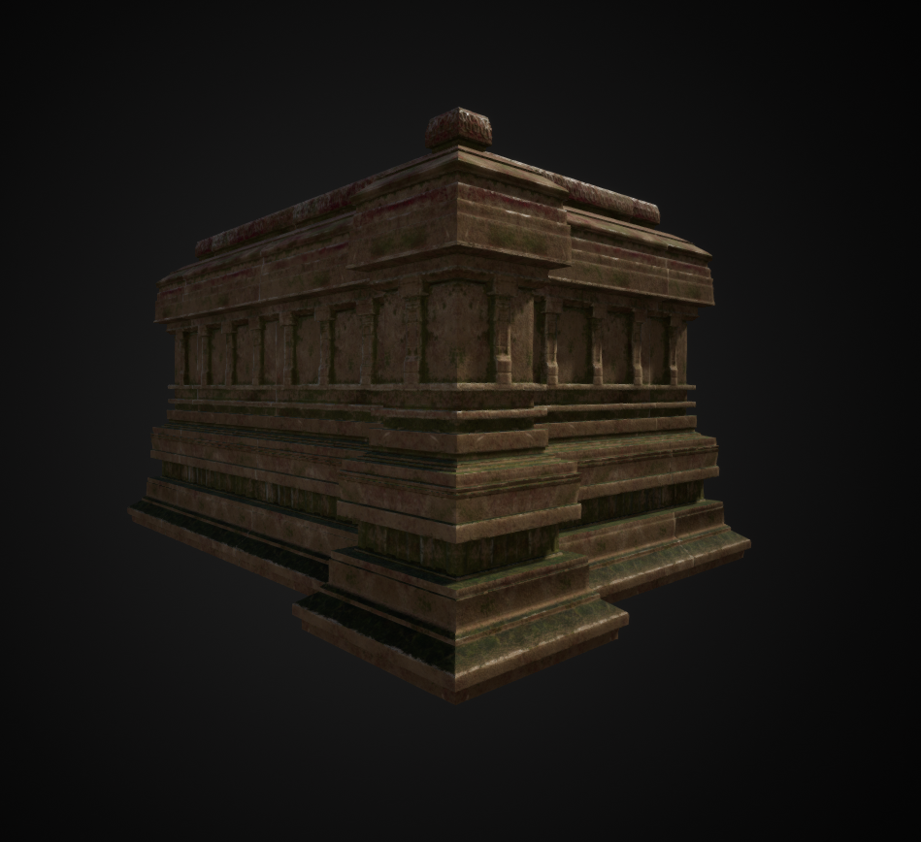

Slide 22
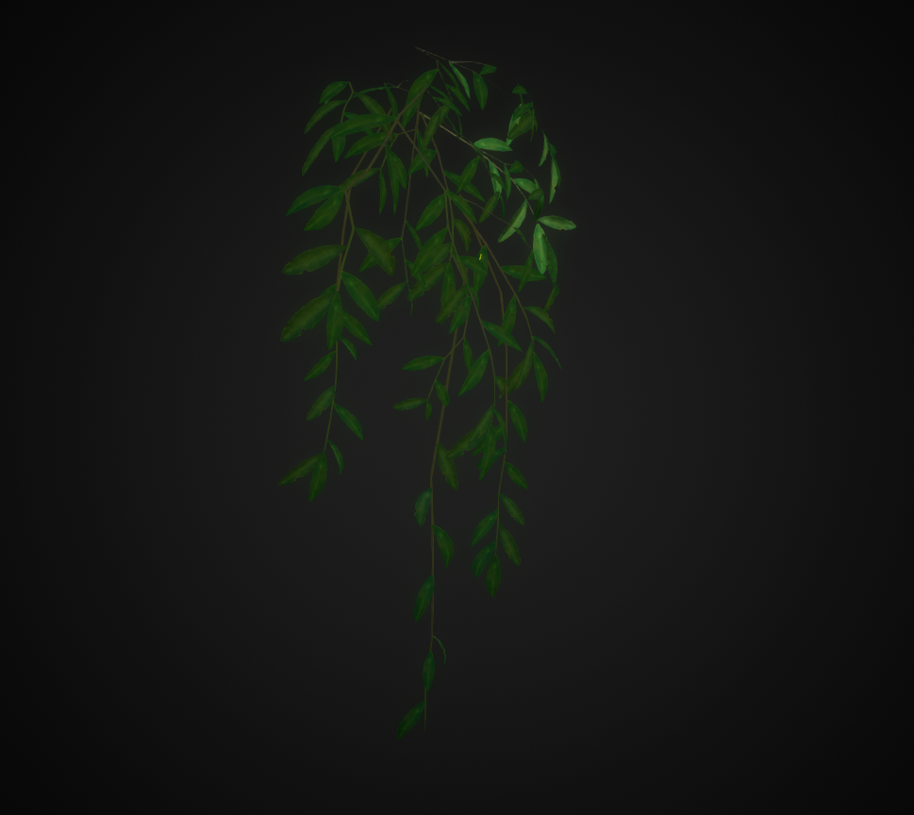
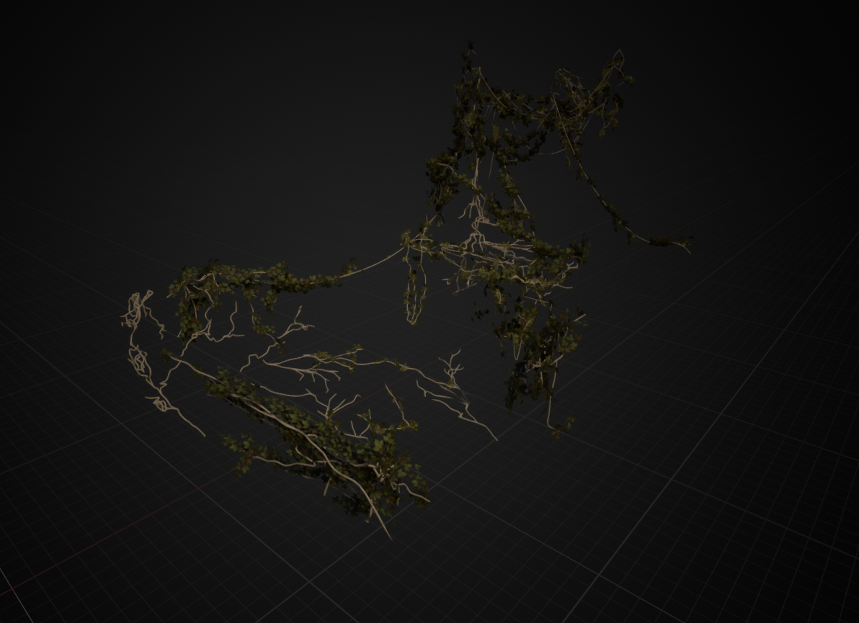

Slide 23
3D Character Art
Door: Sunray Muijsson
Character Final Render
Greyscale Render
Bust iterations
Face Close up
Face Textures

Slide 24
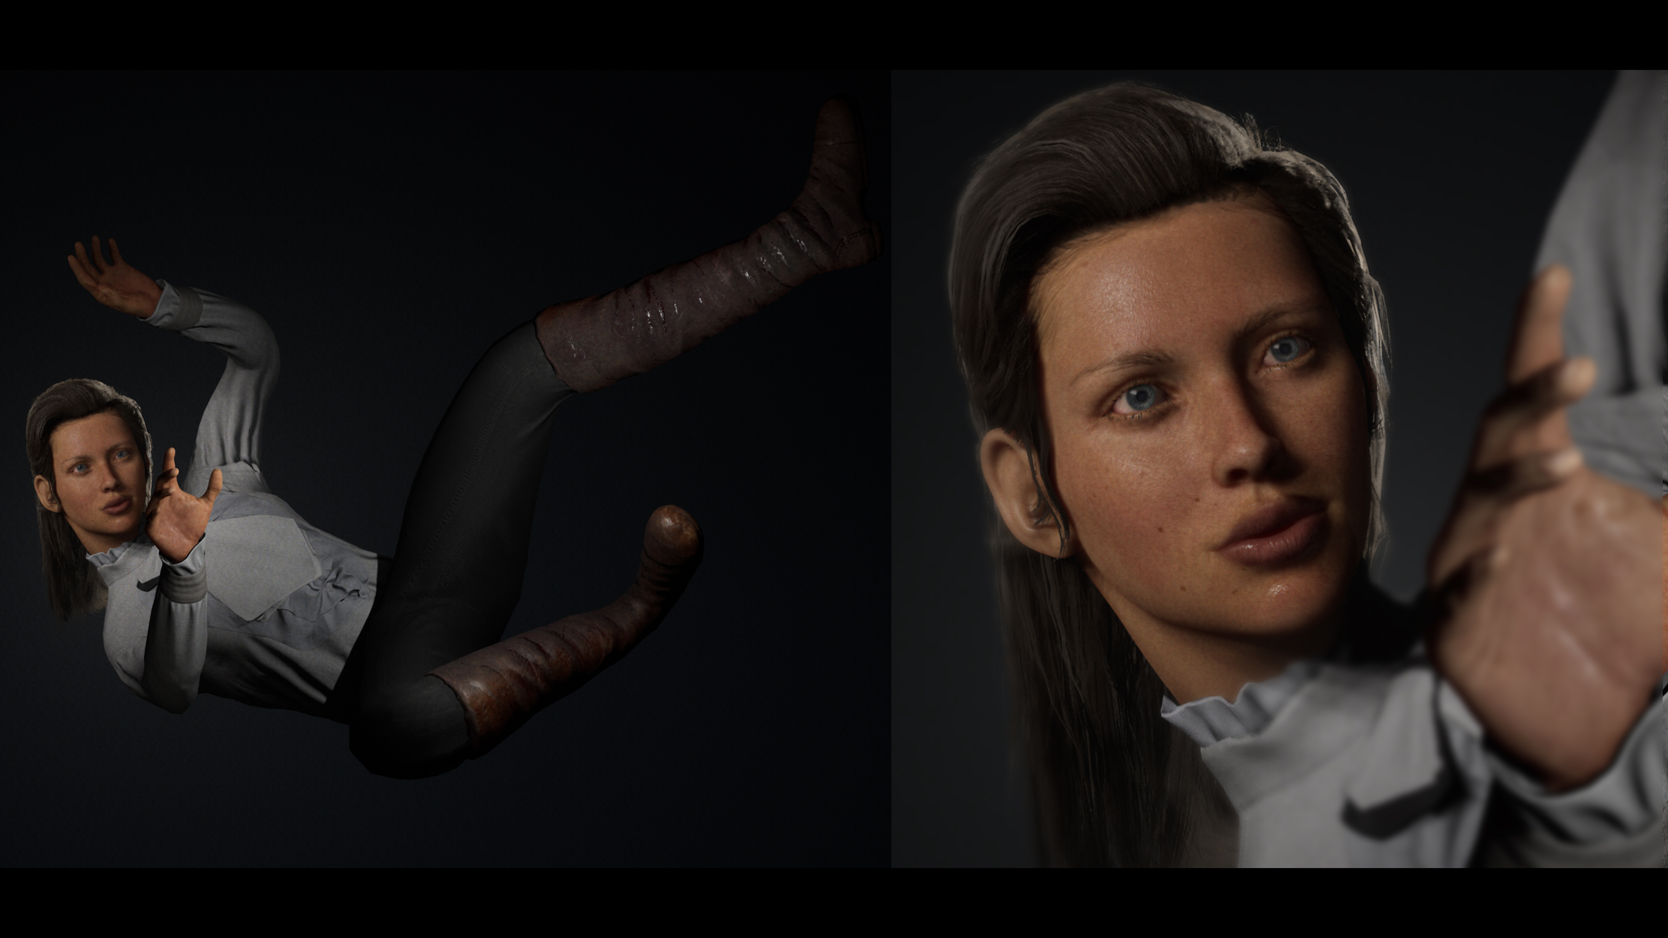

Slide 25
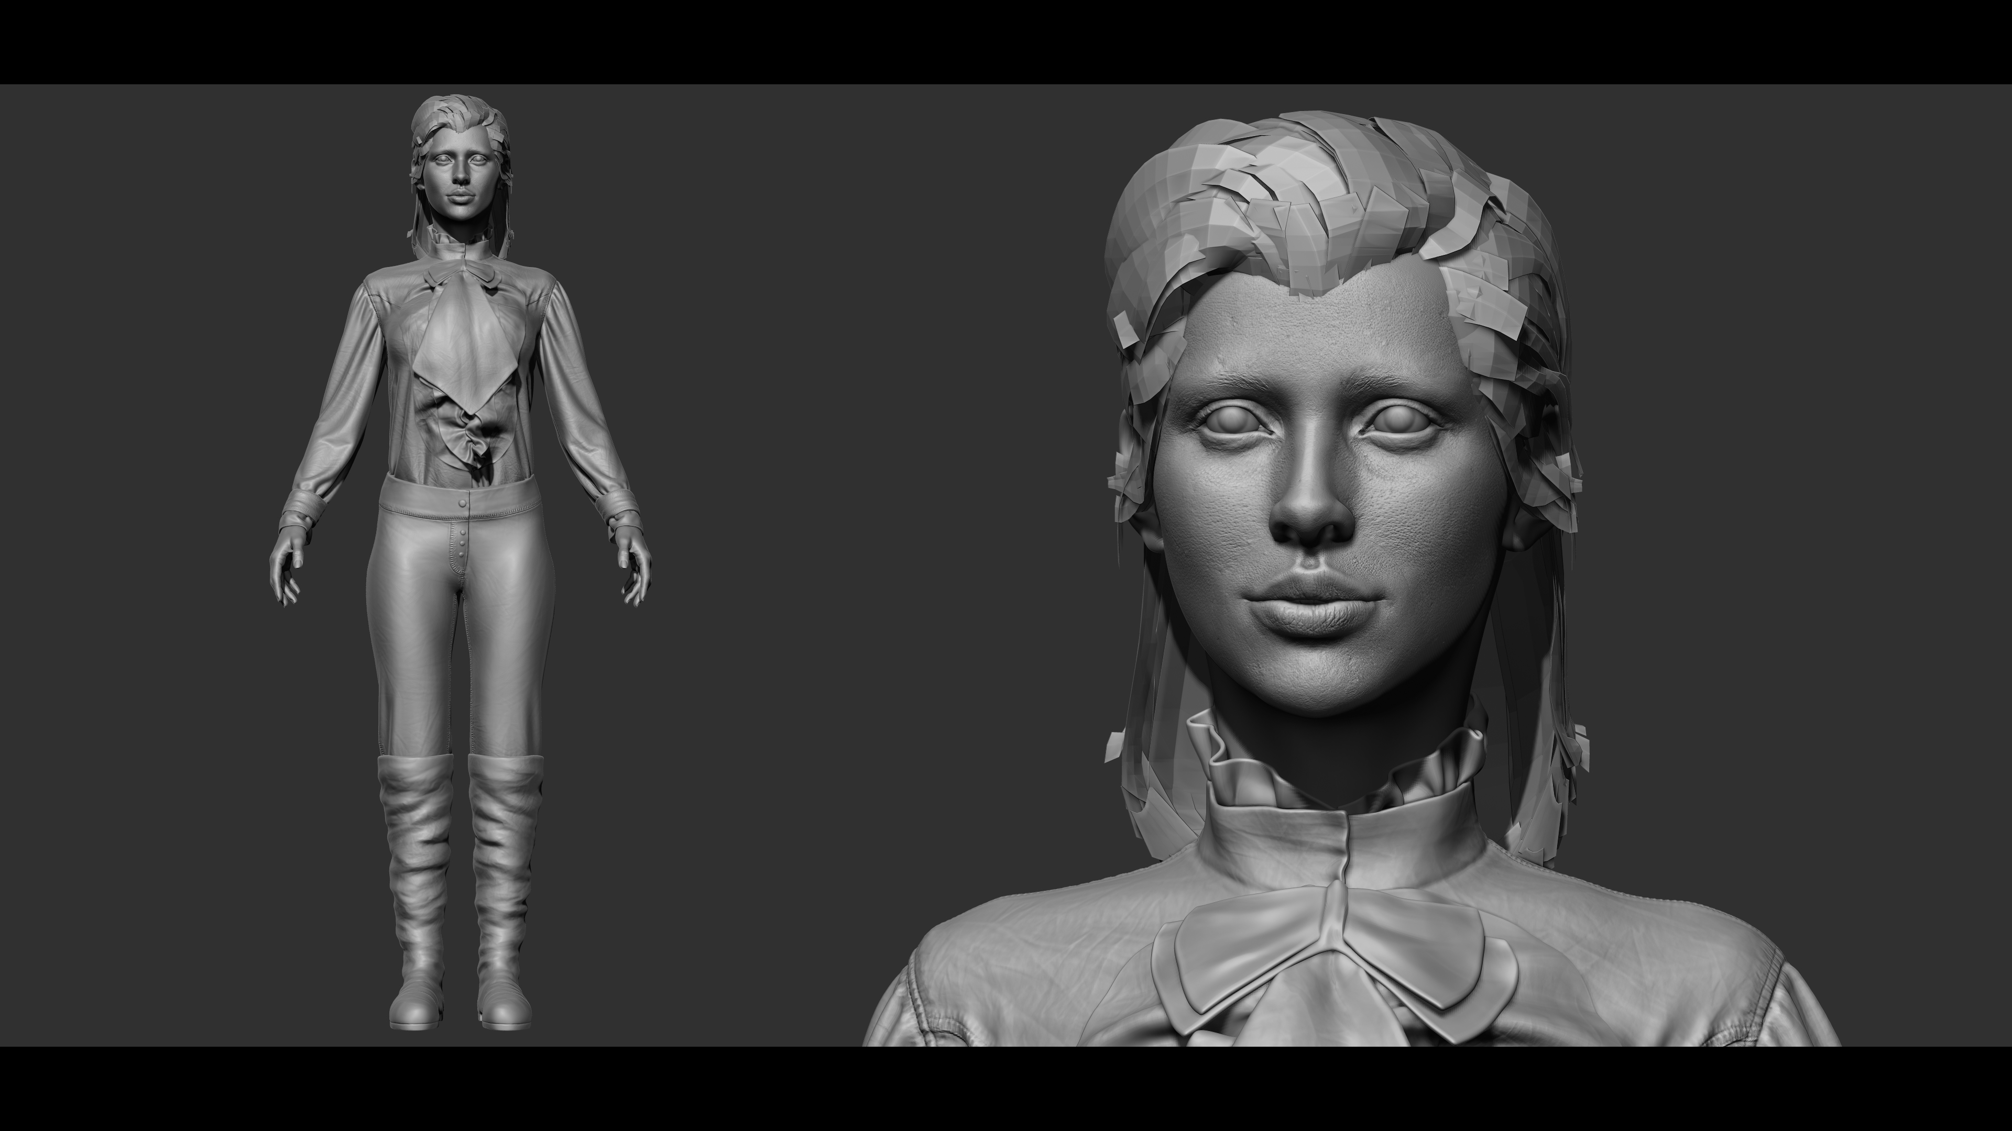

Slide 26
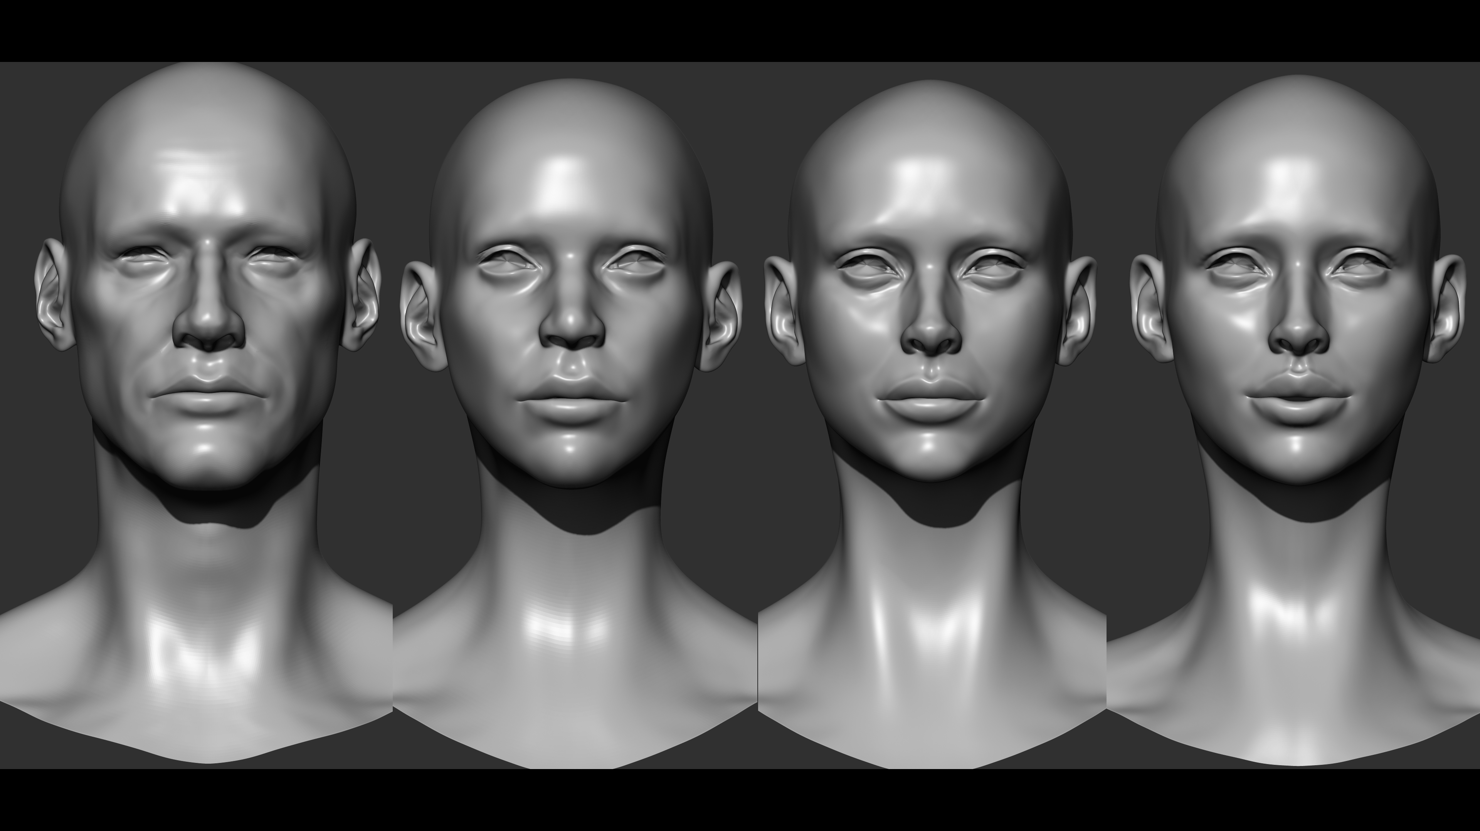

Slide 27
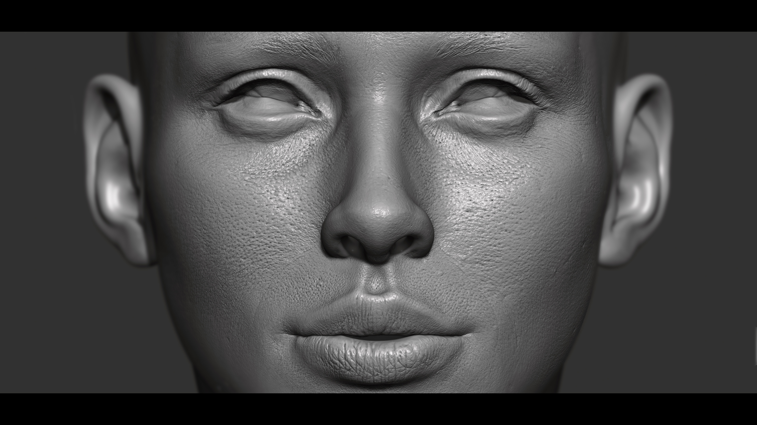

Slide 28
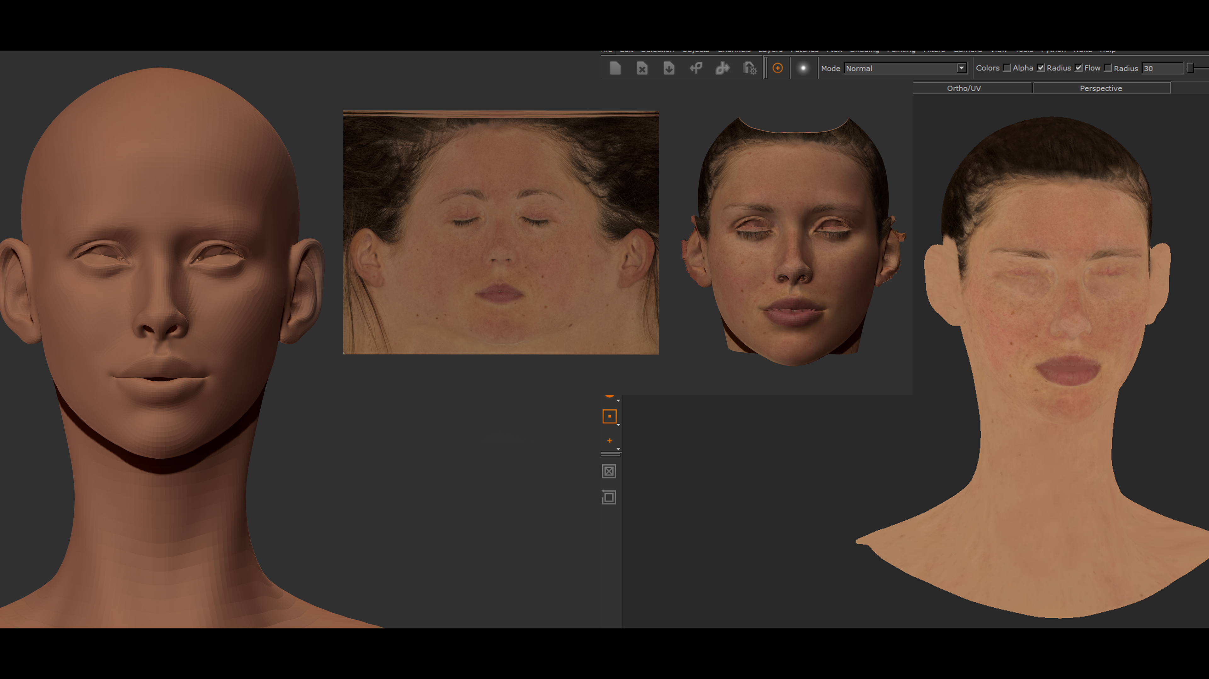

Slide 29
3D Weapon Art
Door: Rick Greeve
Weapon Render
Reference Image
More weapon Renders
Bullet and Magazine Render

Slide 30
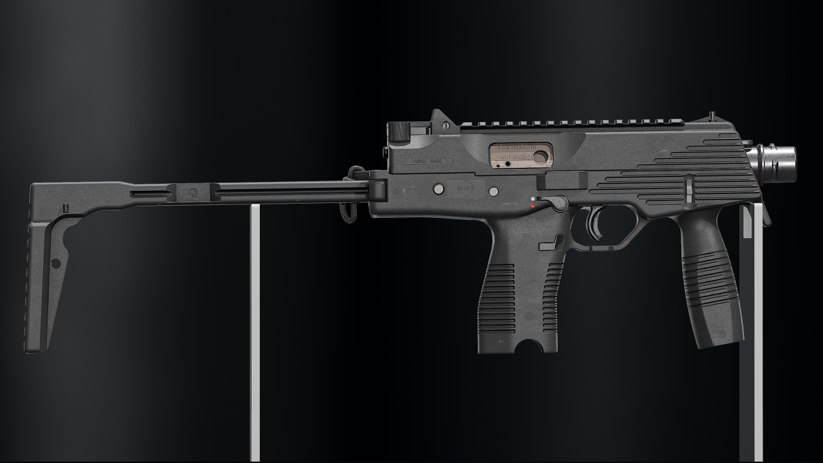

Slide 31
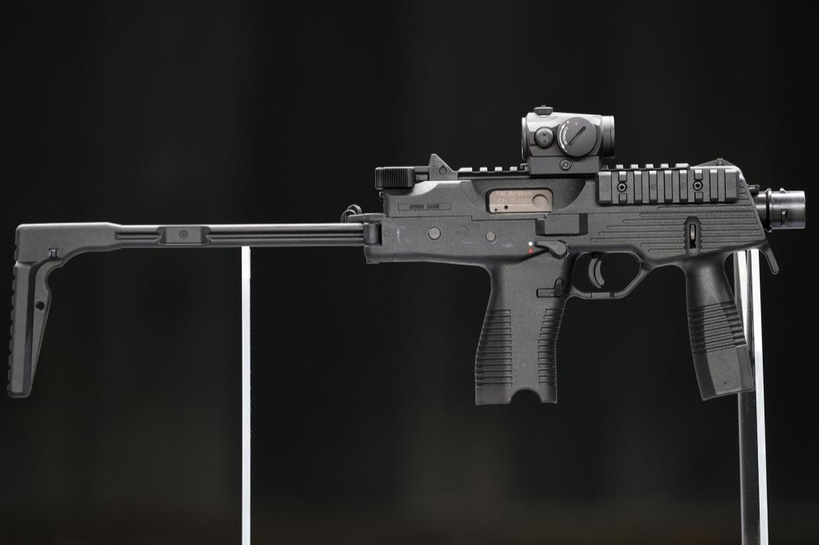

Slide 32
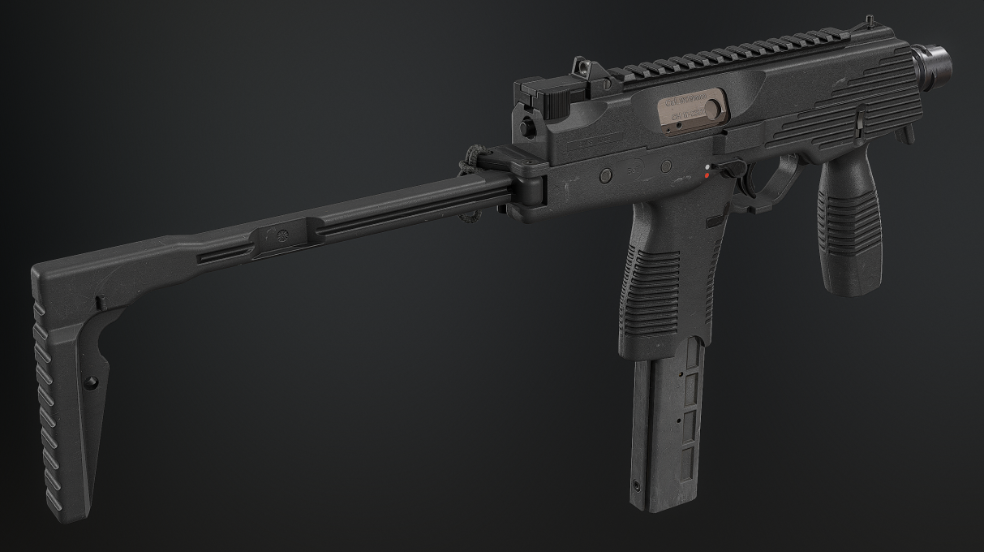

Slide 33
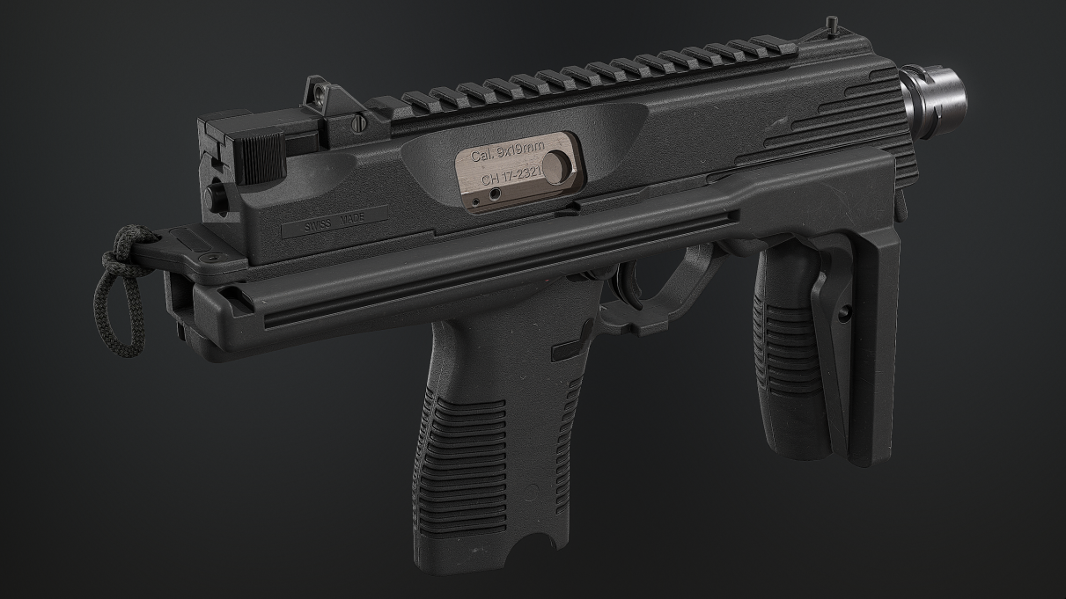

Slide 34
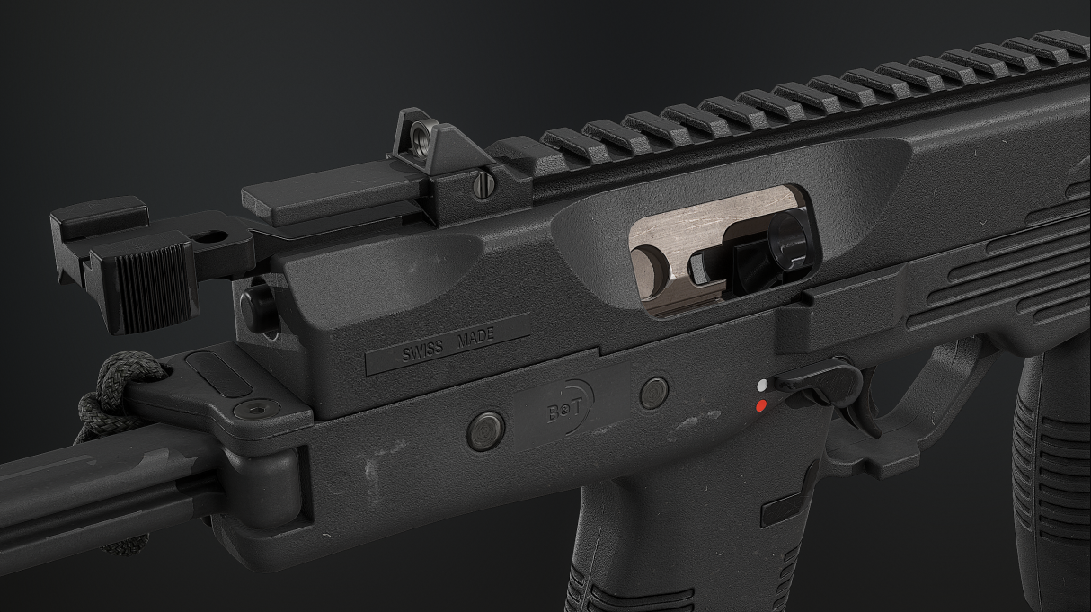

Slide 35
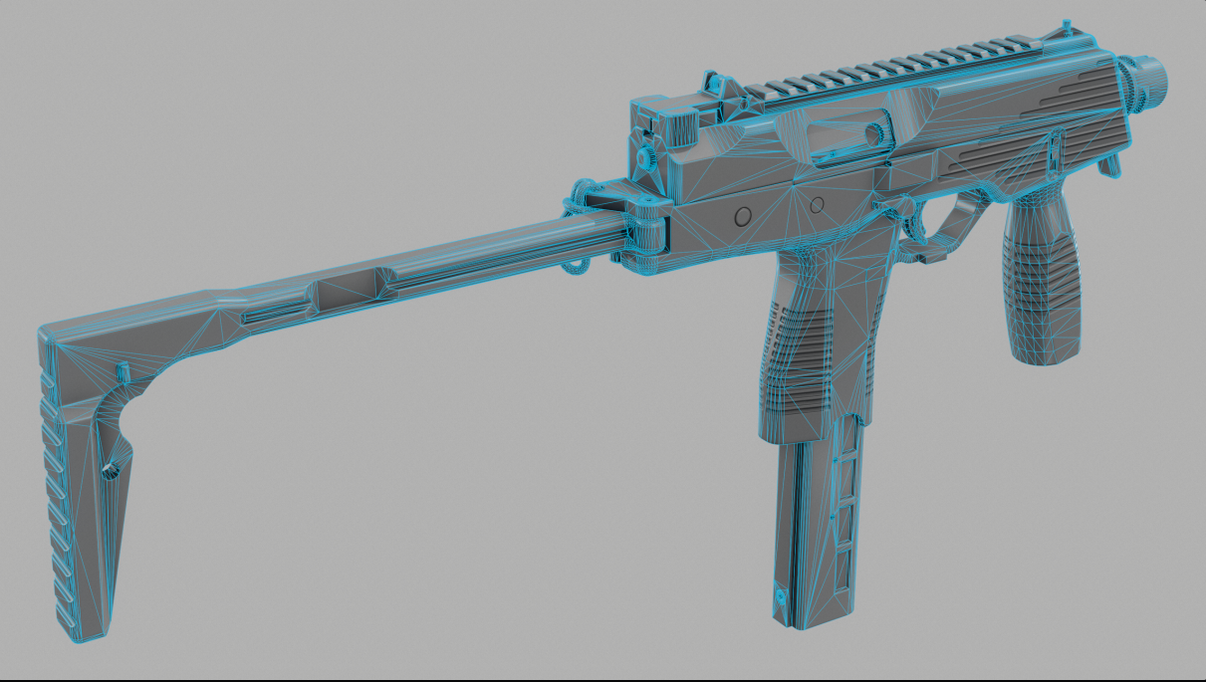

Slide 36
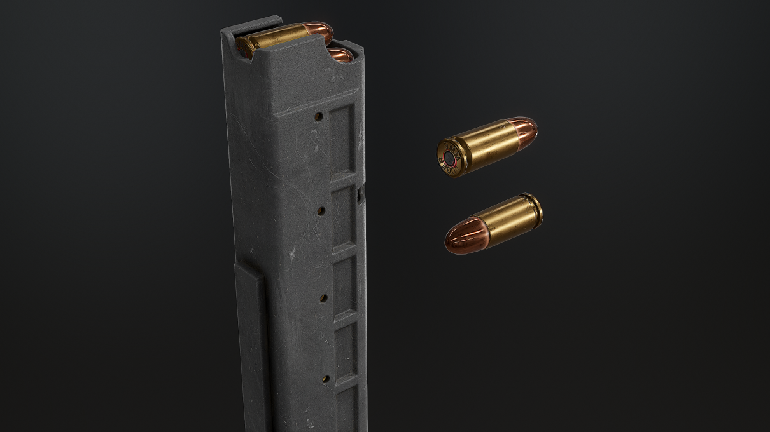

Slide 37
Einde Presentatie
Bedankt voor uw aandacht
Zijn er nog vragen?

